Slide 1
Group 8
Design Masterclass – Bandai Namco Brief
Max Carter & Rebecca Brannum

Slide 2
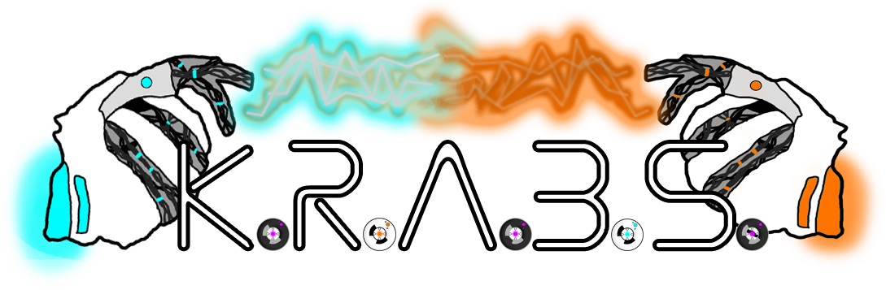
The Game – K.R.A.B.S.
Game we created for Ludum Dare 38
Currently Windows standalone
We will be porting it to Android
Notes:
Adapting a game we created for Ludum Dare 38 Currently a windows standalone, we’ll be porting it to android, adjusting the mechanics to be appropriate for the brief

Slide 3



What is K.R.A.B.S?
2D
2 player
Single screen
Simultaneous, symmetrical play
Resource gathering and battling
Notes:
Single screen 2 players 2D Simultaneous, symmetrical play Resource gathering + battling Currently just 1 level

Slide 4

Game Showcase

Slide 5
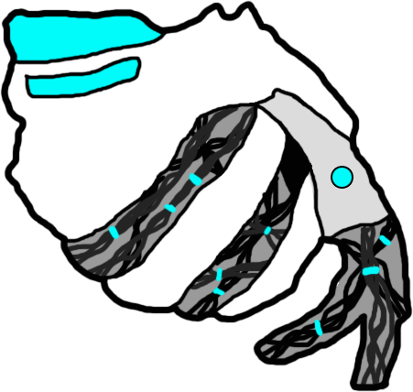

What are we Adding?
More characters
Character animations
Stage selection
Tournament mode
Notes:
Add additional characters to choose from Animations for characters Stage selection Tournament mode Main menu (options)

Slide 6

To fit the brief…
Change the control scheme (touch screen friendly)
Replace numerous premade assets
Remove the AI option
Notes:
Removing the AI options
Changing control scheme to be touch screen friendly
Replace numerous premade assets

Slide 7
Questions?

